Slide 1
Standard Deviation and variance
By
Aniket A. Patil

Slide 2
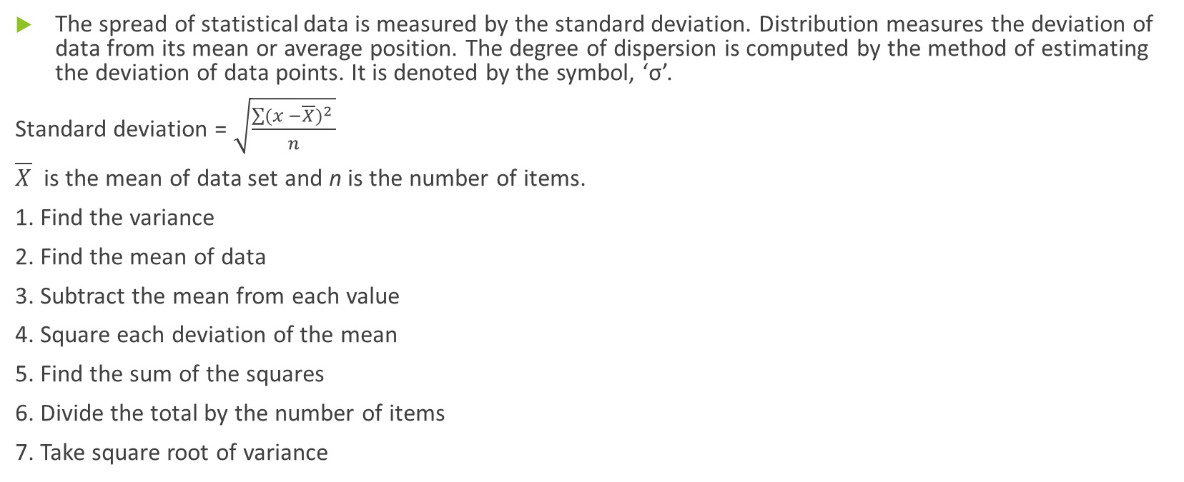
Standard Deviation
The spread of statistical data is measured by the standard deviation. Distribution measures the deviation of data from its mean or average position. The degree of dispersion is computed by the method of estimating the deviation of data points. It is denoted by the symbol, ‘σ’.
Standard deviation = $\sqrt{\frac{\sum{{(x −\overline{X})}^{2} }}{n}}$
$\overline{X}$ is the mean of data set and n is the number of items.
1. Find the variance
2. Find the mean of data
3. Subtract the mean from each value
4. Square each deviation of the mean
5. Find the sum of the squares
6. Divide the total by the number of items
7. Take square root of variance

Slide 3
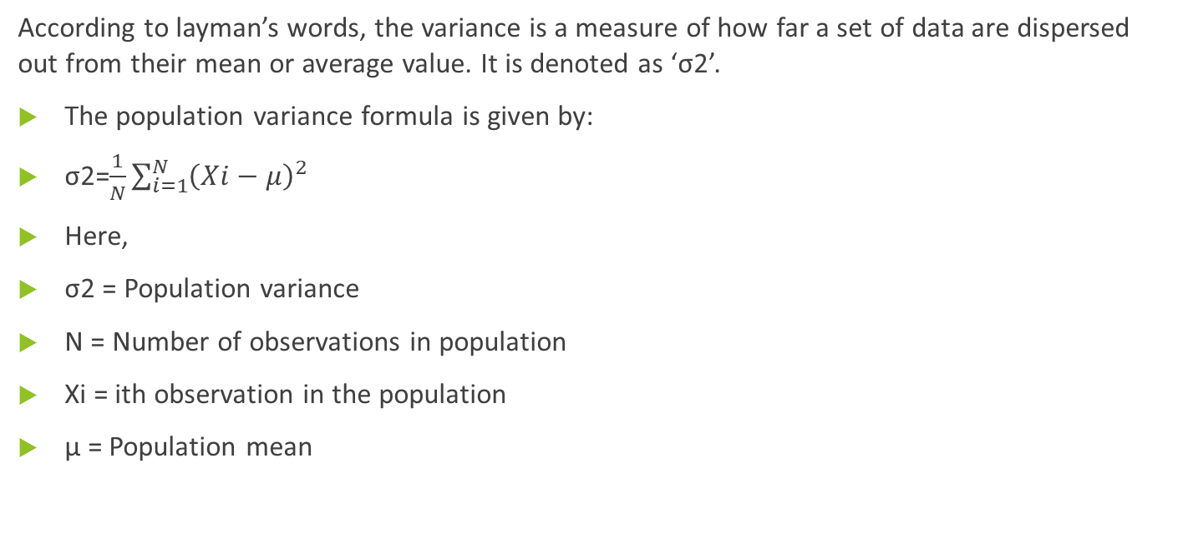
Variance
According to layman’s words, the variance is a measure of how far a set of data are dispersed out from their mean or average value. It is denoted as ‘σ2’.
The population variance formula is given by:
σ2=$\frac{1}{N}\sum_{i=1}^{N}{{\left(Xi−μ\right)}^{2} }$
Here,
σ2 = Population variance
N = Number of observations in population
Xi = ith observation in the population
μ = Population mean

Slide 4
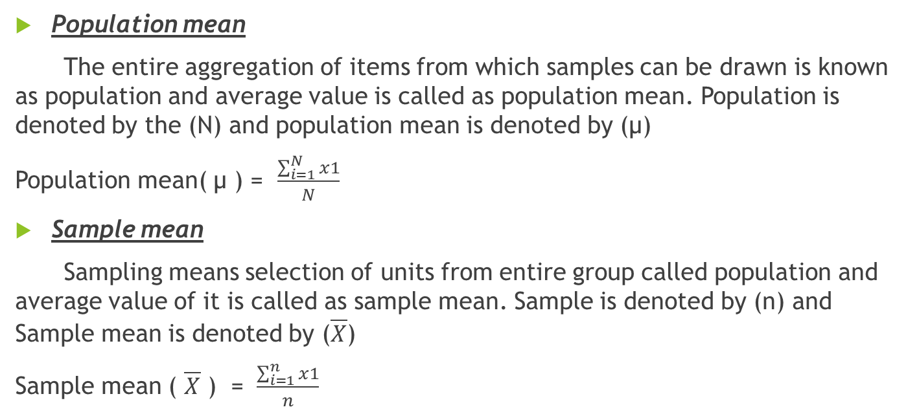
population mean and sample mean
Population mean
The entire aggregation of items from which samples can be drawn is known as population and average value is called as population mean. Population is denoted by the (N) and population mean is denoted by (µ)
Population mean( µ ) = $\frac{\sum_{i=1}^{N}{x1}}{N}$
Sample mean
Sampling means selection of units from entire group called population and average value of it is called as sample mean. Sample is denoted by (n) and Sample mean is denoted by ($\overline{X}$)
Sample mean ( $\overline{X}$ ) = $\frac{\sum_{i=1}^{n}{x1}}{n}$

Slide 5

Find mean, mode, median, standard deviation
a) 7,11,16,14,11,13,19,13,13
Mean = $\frac{7+11+16+14+11+13+19+13+13}{9}$
= 117/9
= 13
Mode
Mode is the highest occurring element. Here we see that 13 is the highest occurring element. So mode of this series is 13
Mode = 13

Slide 6
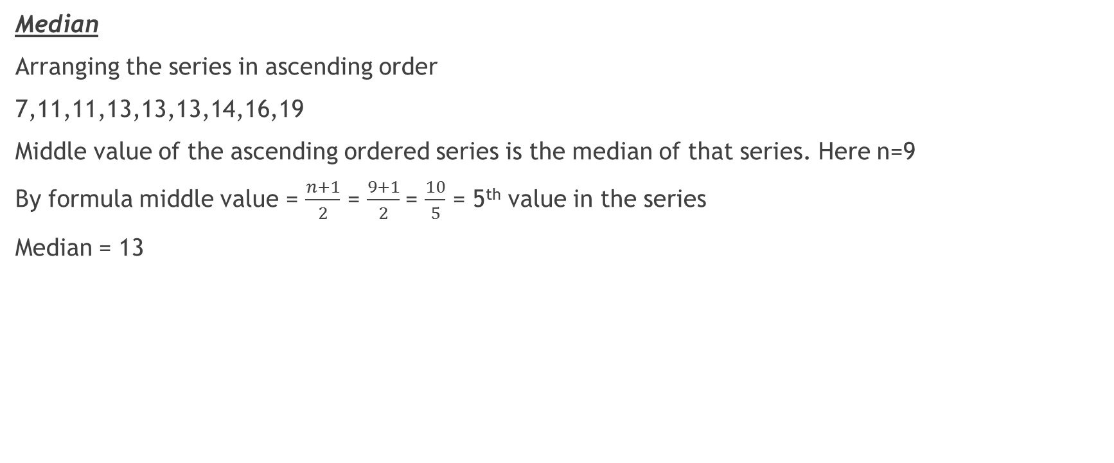
Median
Arranging the series in ascending order
7,11,11,13,13,13,14,16,19
Middle value of the ascending ordered series is the median of that series. Here n=9
By formula middle value = $\frac{n+1}{2}$ = $\frac{9+1}{2}$= $\frac{10}{5}$ = 5th value in the series
Median = 13

Slide 7

b) 16,15,16,17,19,12,14,9
Mean = $\frac{16+15+16+17+19+12+14+9}{8}$
= $\frac{118}{8}$
Mean = 14.75
Mode
Mode is the highest occurring element. Here we see that 16 is the highest occurring element. So mode of this series is 16
Mode = 16

Slide 8

Median
Arranging the series in ascending order
9,12,14,15,16,16,17,19
Middle value of the ascending ordered series is the median of that series. Here n= 8
By formula middle value =[ $\frac{[\left(\frac{n}{2}\right)th+\left(\frac{n}{2}+1\right)th]}{2}]$
= [ $\frac{[\left(\frac{8}{2}\right)th +\left[\left(\frac{8}{2}\right)+1\right]th]}{2} ]$
= $\frac{(15+16)}{2}$
= $\frac{31}{2}$
Median = 15.5

Slide 9

C) 27,66,24,81,50,40,74,81,97
Mean
= $\frac{Summation ofall elements of series}{number of elements}$
= $\frac{27+66+24+81+50+40+74+81+97}{9}$
= $\frac{540}{9}$
Mean = 60
Mode
Mode is the highest occurring element. Here we see that 81 is the highest occurring element. So mode of this series is 81
Mode = 81

Slide 10

Median 27,66,24,81,50,40,74,81,97
Arranging the series in ascending order
24,27,40,50,66,74,81,81,97
Middle value of the ascending ordered series is the median of that series. Here n=9
By formula middle value = $\frac{n+1}{2}$ = $\frac{9+1}{2}$= $\frac{10}{5}$ = 5th value in the series
Median = 66

